Slide 1

Big Data Analytics (ISOM 5270)
Predictive
by Prof. Fernández-Loría

Slide 2
There won’t be a quiz today.

Slide 3
The Plan
Week 1: Problem formulation.
Week 2: Modeling (Part 1).
Week 3: Modeling (Part 2).
Week 4: Model Evaluation.
Week 5: Causal analytics.
Week 6: Big (unstructured) data.
Week 7: Generative AI.
Week 8: Final Exam.
Fundamentals
(What I think are) The Big Three

Slide 4


Today it will be a
little more this…
…than this
Notes:
https://www.westpoint.edu/sites/default/files/pdfs/SCPME/CharacterDevelopmentStrategy.pdf
(page 12)

Slide 5
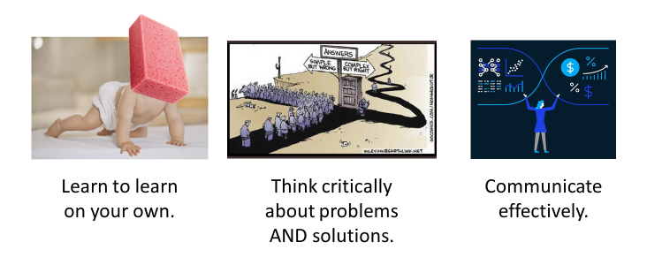
The Effectiveness (and Ineffectiveness) of Lectures
What is a lecture
NOT
so good for?
What is a lecture good for?
Fostering active learning.
Presenting current information.
Stimulating higher
-
order thinking.
Summarizing material.
Engaging learners.
Focusing on a particular area of interest.
Developing learners’ skills.
Relaying key concepts or ideas.
Exploring attitudes or values.
Building interest.

Slide 6
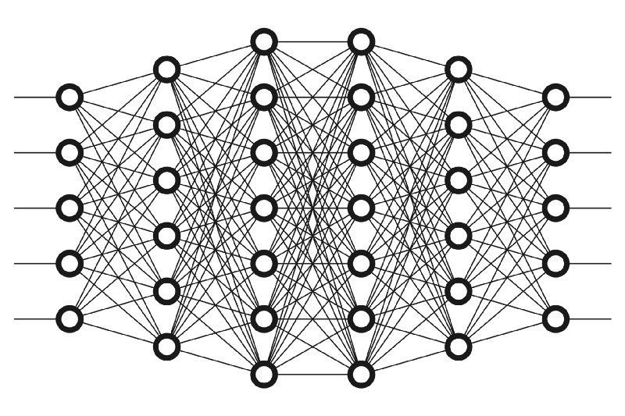
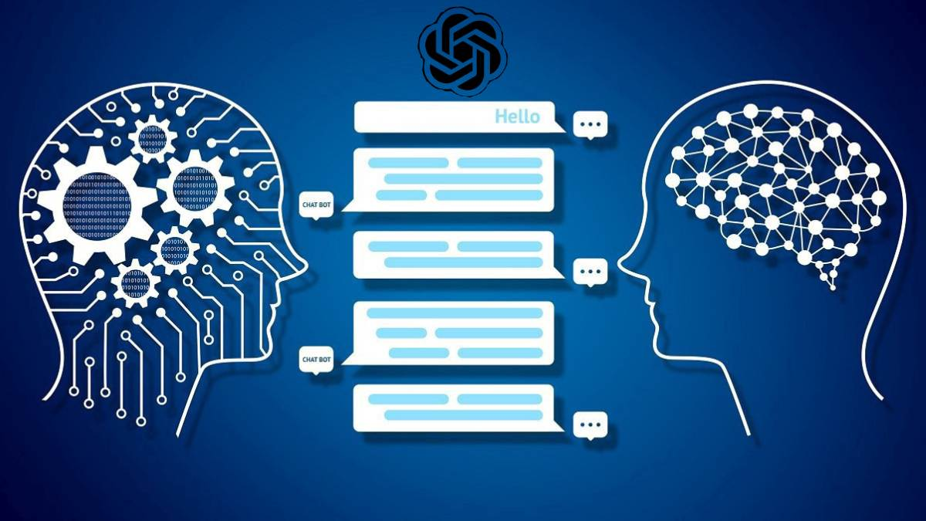

Focus of Today:
Basics of deep learning and embeddings.
Large language models.
The course main takeaways.

Slide 7
Let’s talk about deep learning.
This assumes you watched the neural networks video from 3Blue1Brown.
https://www.youtube.com/watch?v=aircAruvnKk

Slide 8
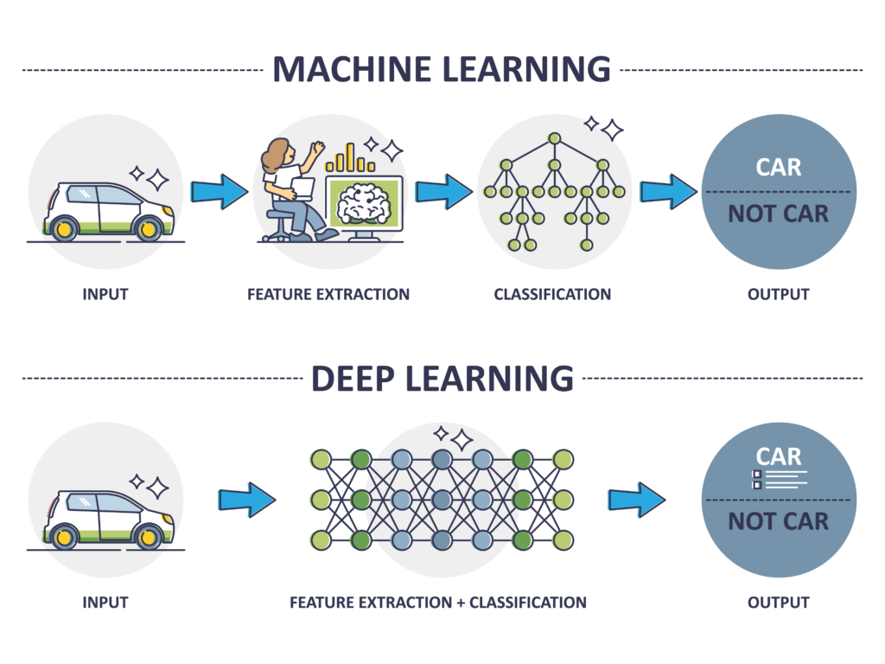

Slide 9

Neural Networks (Deep Learning)
A neural network is a “stack” of models, where each layer generates increasingly complex (and non-linear) representations of the features:
Models (e.g., logistic regression)
Notes:
Hidden layers, cada neurona es un “feature”. Layers mas arriba son mas “elaborados”.
Dar ejemplo con 8, primera capa pixeles, edges, patrones, si es 8 o no.
Cada modelo (neurnoa) para predecir si es cierto que el feature esta presente.

Slide 10
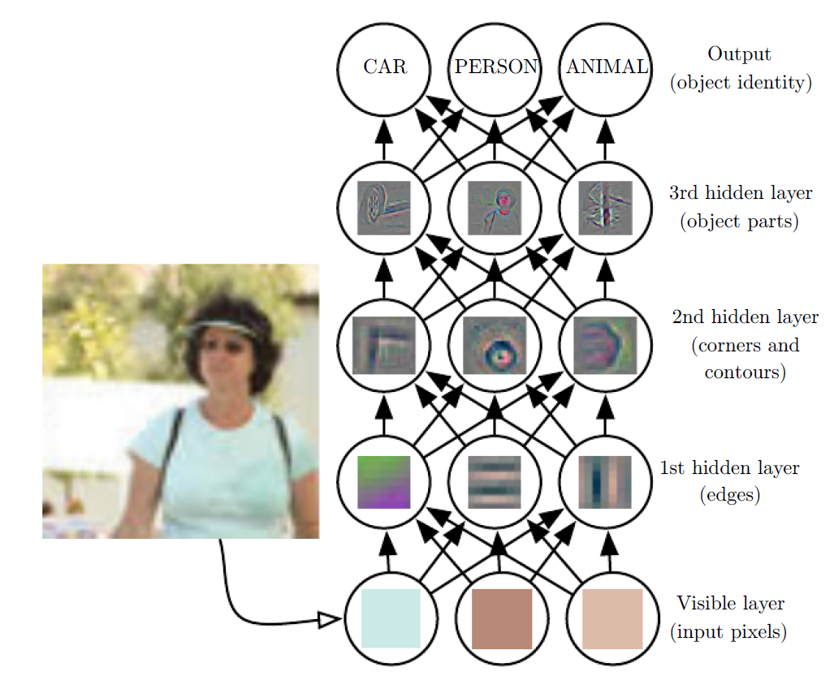
Intuition for why it works:

Slide 11
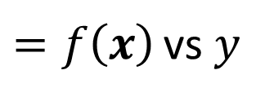
How do we learn these representations?
We only need a (differentiable) objective function:
$=f\left(x\right)$ vs $y$
The network is a group of parameters that defines a complex mathematical function. The algorithm “wiggles” parameters with large derivatives.

Slide 12

Framework #5: Components of Machine Learning
Machine learning algorithms are programs that fit a model to data based on an evaluation criterion.
Representation $+$ Evaluation $+$ Optimization
$$\underset{\hat{q}}{argmin}{\sum_{∀i∈Data}{error\left(q_{i},\hat{q}\left(x_{i}\right)\right)}}$$

Slide 13
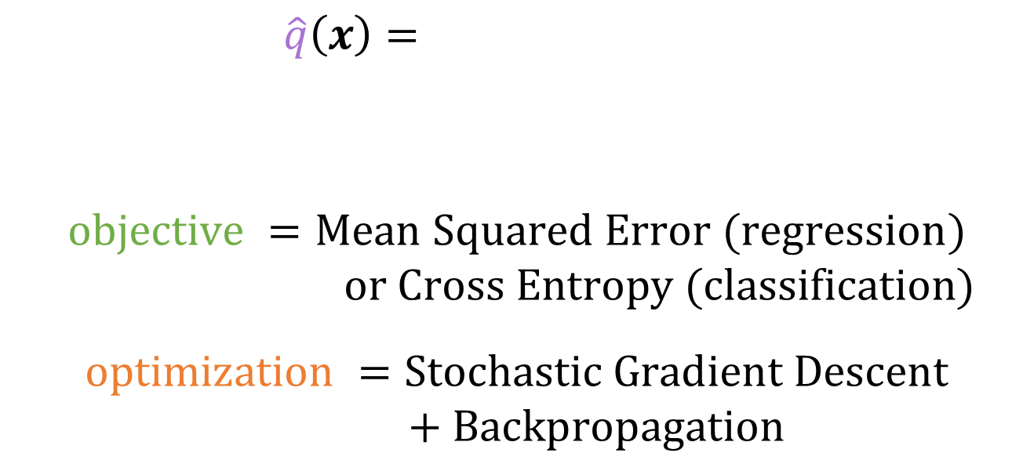
Learning = Representation $+$ Evaluation $+$ Optimization
Neural Networks
$\hat{q}\left(x\right)=$
$$objective =Mean Squared Error (regression)$$
$or Cross Entropy (classification)$
$$optimization =Stochastic Gradient Descent$$
$+ Backpropagation$
(Must be differentiable!)

Slide 14
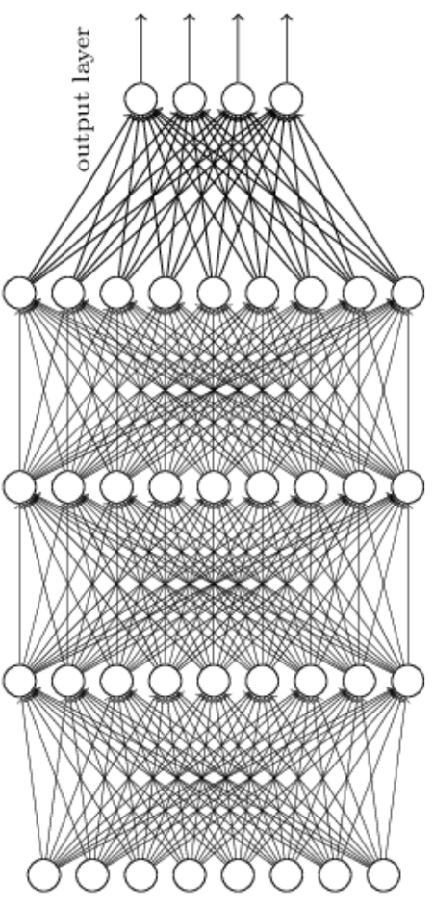
In practice, there may be no direct match.
May not match!
May not match!
May not match!

Slide 15
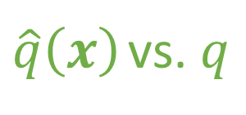
$\hat{q}\left(x\right)$ vs. $q$
But the algorithm will learn the parameters (representations) that optimize the objective function.
Deep learning is about learning predictive feature representations.

Slide 16

Representation $+$ Evaluation $+$ Optimization
There are many “architectures” for Neural Networks. Many are for purpose-specific applications.
Image taken from:
https://www.asimovinstitute.org/neural-network-zoo/

Slide 17
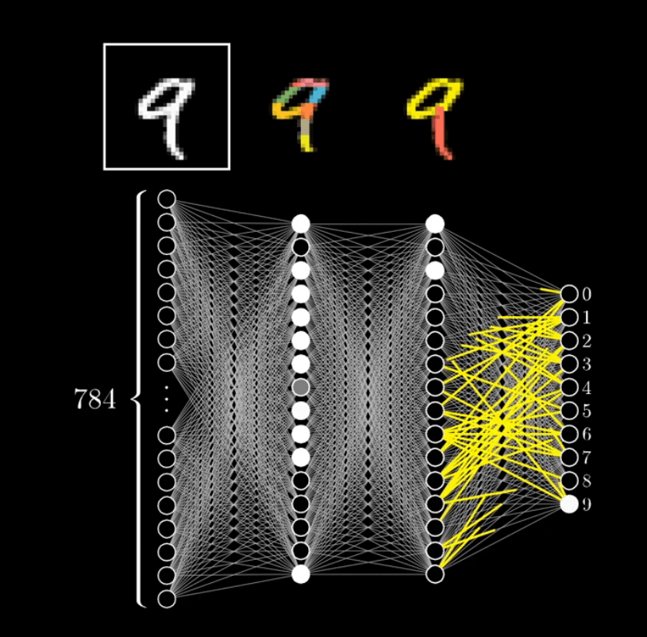
Representation $+$ Evaluation $+$ Optimization
Often used for predicting multiple outputs.

Slide 18
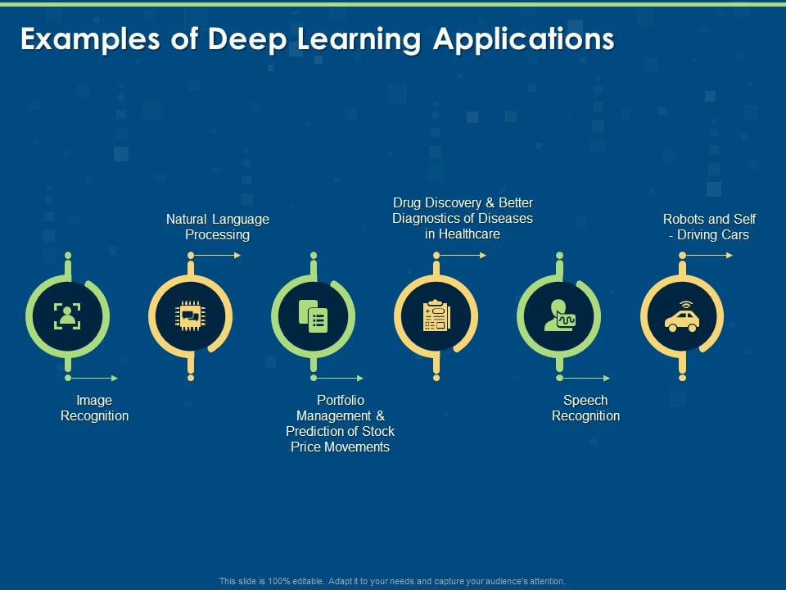
In other words:
Unstructured and high-dimensional data.

Slide 19
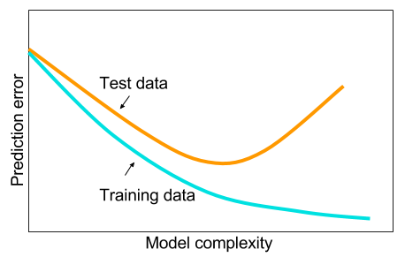
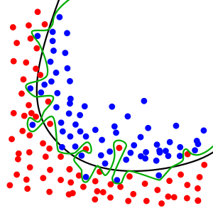
Beware of overfitting…

Slide 20
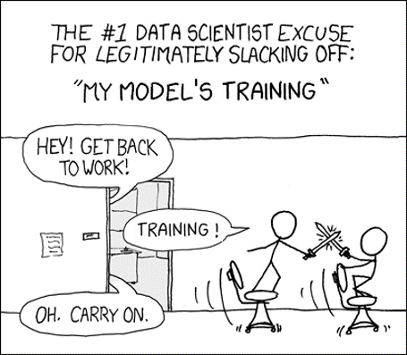
Also…

Slide 21
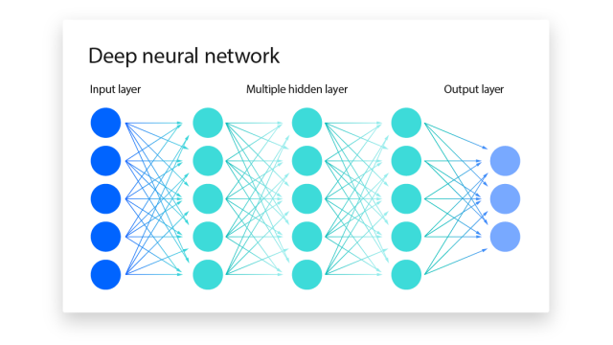
Questions?

Slide 22
Word Embeddings: Deep Learning for Text Data

Slide 23
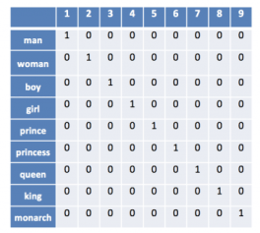
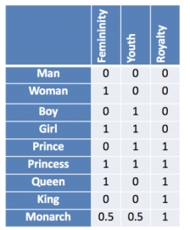
What’s a word embedding?
It is a vector of numbers meant to represent word meaning.
Let’s move from
bag of words…
To word
Embeddings!

Slide 24
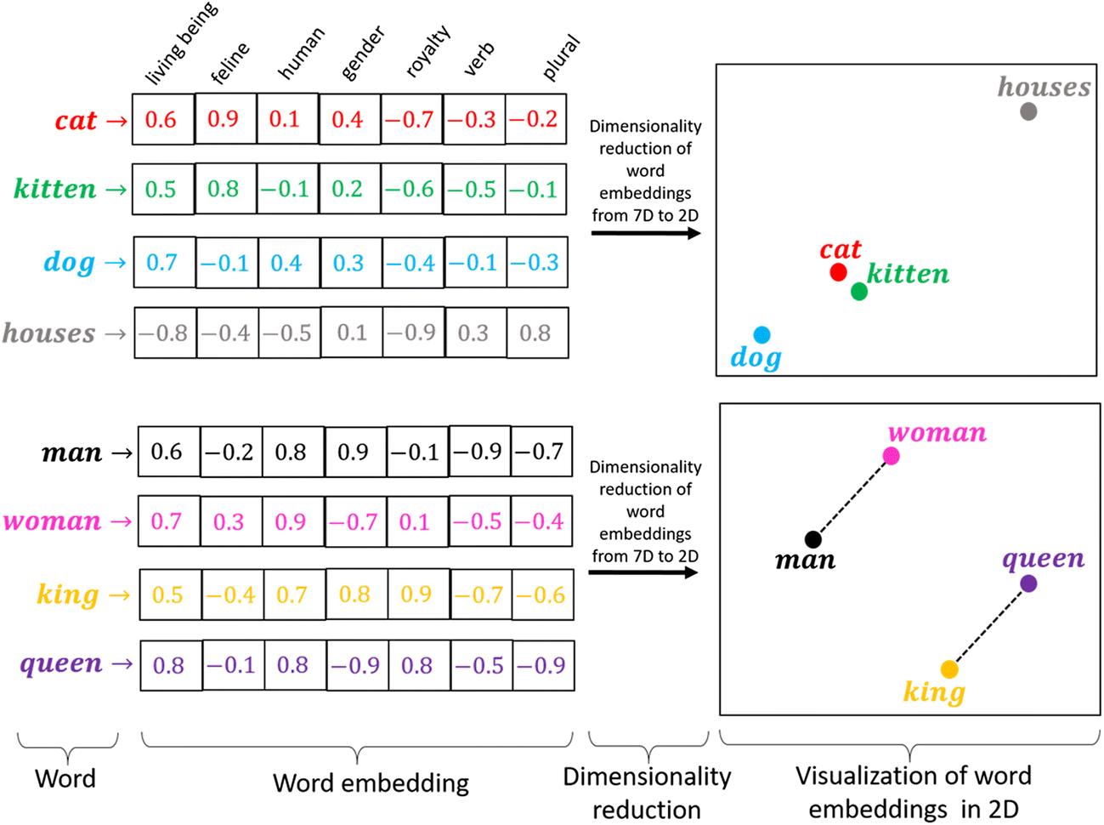
Why are they useful?
To capture
the meaning of words and their relationships with one another.

Slide 25


about deep learning?
Can we learn representations of word meaning from data?
The hidden layers in a neural
network are representations!

Slide 26
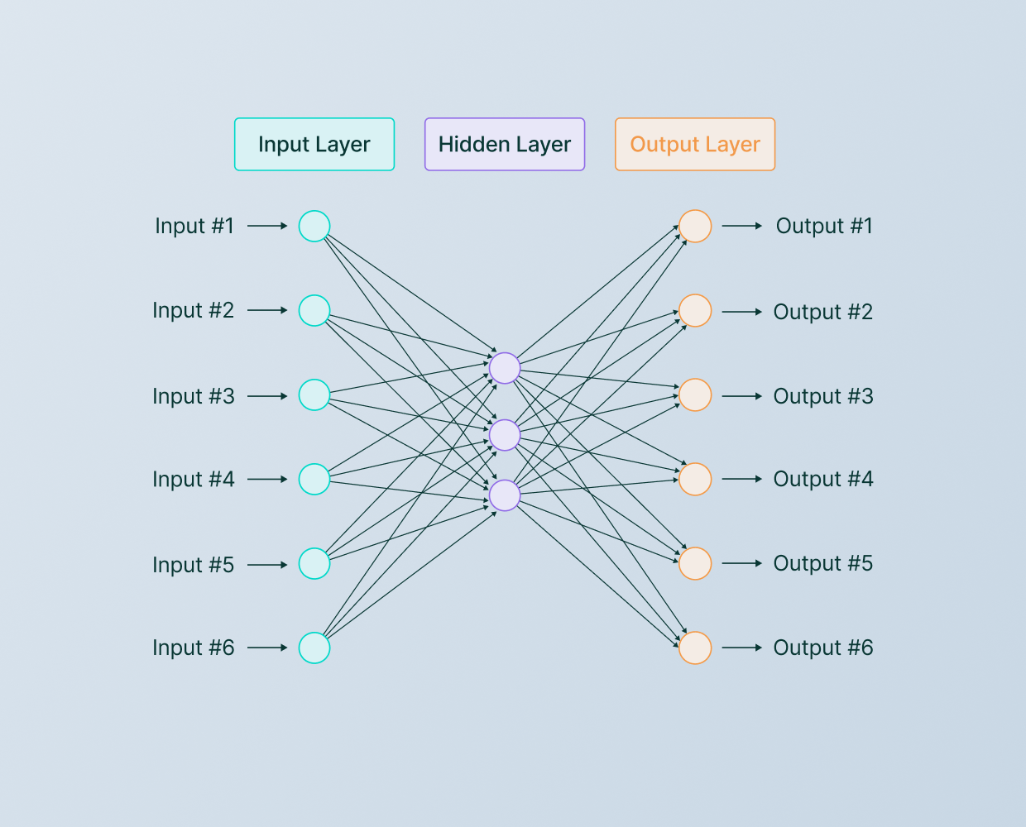
0
1
0
0
0
0
Predict the
meaning of “vehicle”
“vehicle”
Word embedding for “vehicle”
As many features as words exist.

Slide 27

Context $≈$ Meaning
red
“I painted the bench .”
Based on their context, these words have a “similar” meaning.
blue
“I painted the bench .”
green
“I painted the bench .”

Slide 28
Context $≈$ Meaning
red
“I painted the bench .”
Based on their context, these words have a “similar” meaning.
blue
“I painted the bench .”
green
“I painted the bench .”
today
With some caveats...
“I painted the bench .”

Slide 29
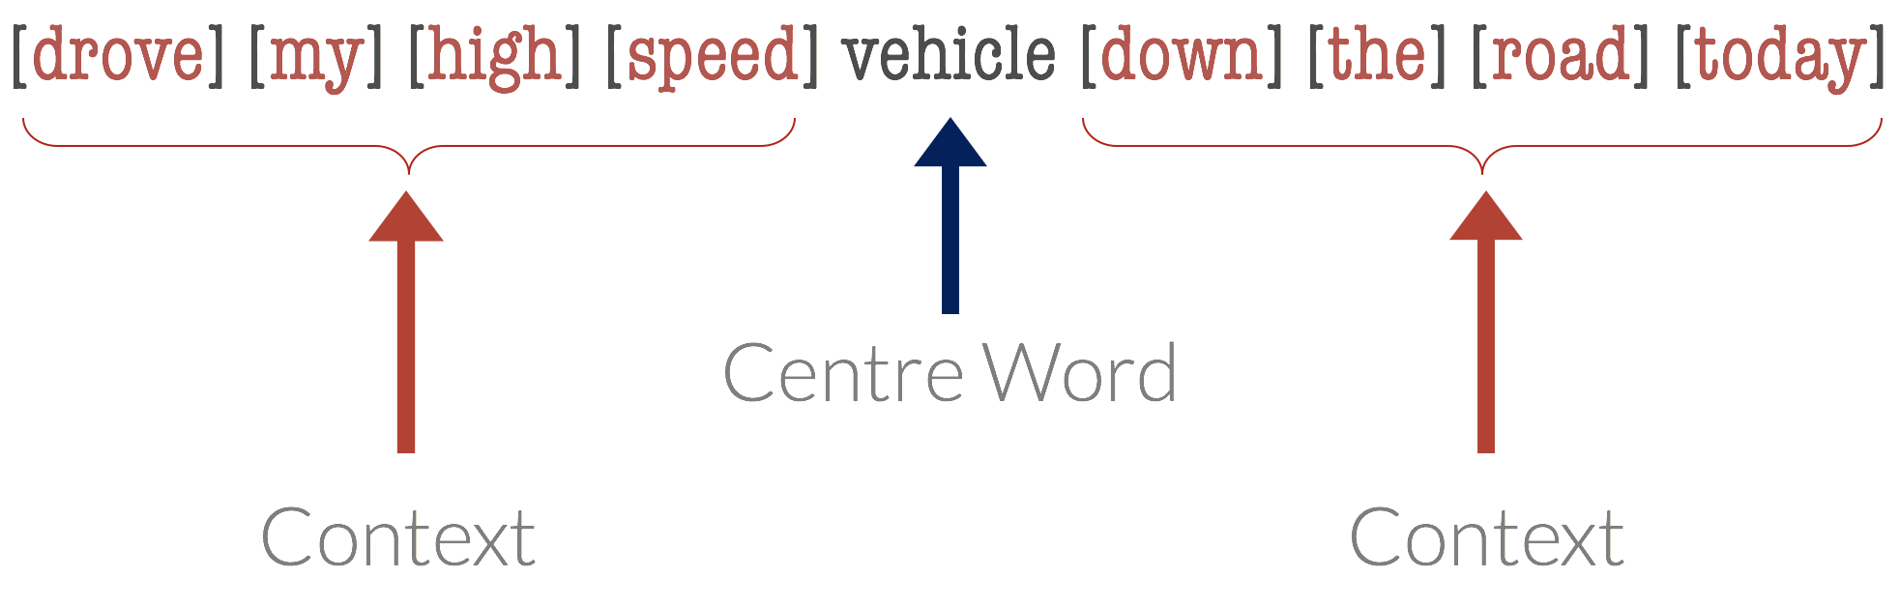
Learning embeddings from data
“drove”
“my”
“high”
“speed”
“down”
“the”
“road”
“today”
Predict context based on centre word.
word2vec
“vehicle”
Neural network!

Slide 30
Questions?
word2vec
Let’s zoom into a single output prediction
0
1
0
0
0
0
“my”
“high”
“speed”
“down”
“the”
“road”
“vehicle”
Predict the
meaning context of “vehicle”
Word embedding for “vehicle”
As many features as words exist.
One output for each word in the context window.

Slide 31
word2vec (neural network)
Scores for context word #1
Word input
0
1
…
0
0
0
…
Embedding
(hidden layer)
…
0.9
0.3
…
0.7
0.2
0.1
“road”
“vehicle”
“banana”
“speed”
“guitar”
“waterfall”

Slide 32
word2vec (neural network)
Scores for context word #1
Word input
1
0
…
0
0
0
…
Embedding
(hidden layer)
…
0.95
0.32
…
0.72
0.24
0.11
“car”
“road”
“banana”
“speed”
“guitar”
“waterfall”
Learn similar representations for words that appear in similar contexts!

Slide 33
Questions?

Slide 34
Other interesting use cases

Slide 35







word2vec
Song input
Playlist output
song2vec
Word input
Context output
0
1
…
0
0
0
…
…
0.9
0.3
…
0.7
0.2
0.1
Embedding
songs
playlists
Learn similar representations for words that appear in similar contexts!

Slide 36
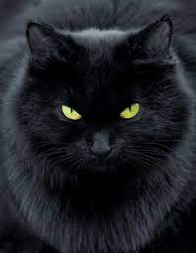
What about learning embeddings with images?
Image prompt
Predict pixel values
1
0
…
1
0
0
…
Embedding
(hidden layer)
…
“black”
“cat”
Learn word representations that capture the “meaning” of images.

Slide 37
Or embeddings for other unstructured data?
Image
Image
Embedding
(hidden layer)
Scores for image prompt
…
…
0.95
0.32
…
0.72
0.24
0.11
“cat”
“animal”
“black”
“eyes”
“fur”
Learn IMAGE representations that match the image prompts.

Slide 38
textual
visual
Meaning
Concept of a
black cat.
numeric
black cat
0.6 | 0.3 | 0.1 | …
Representation
Embedding
Learn with deep learning
by predicting pairs of objects.

Slide 39
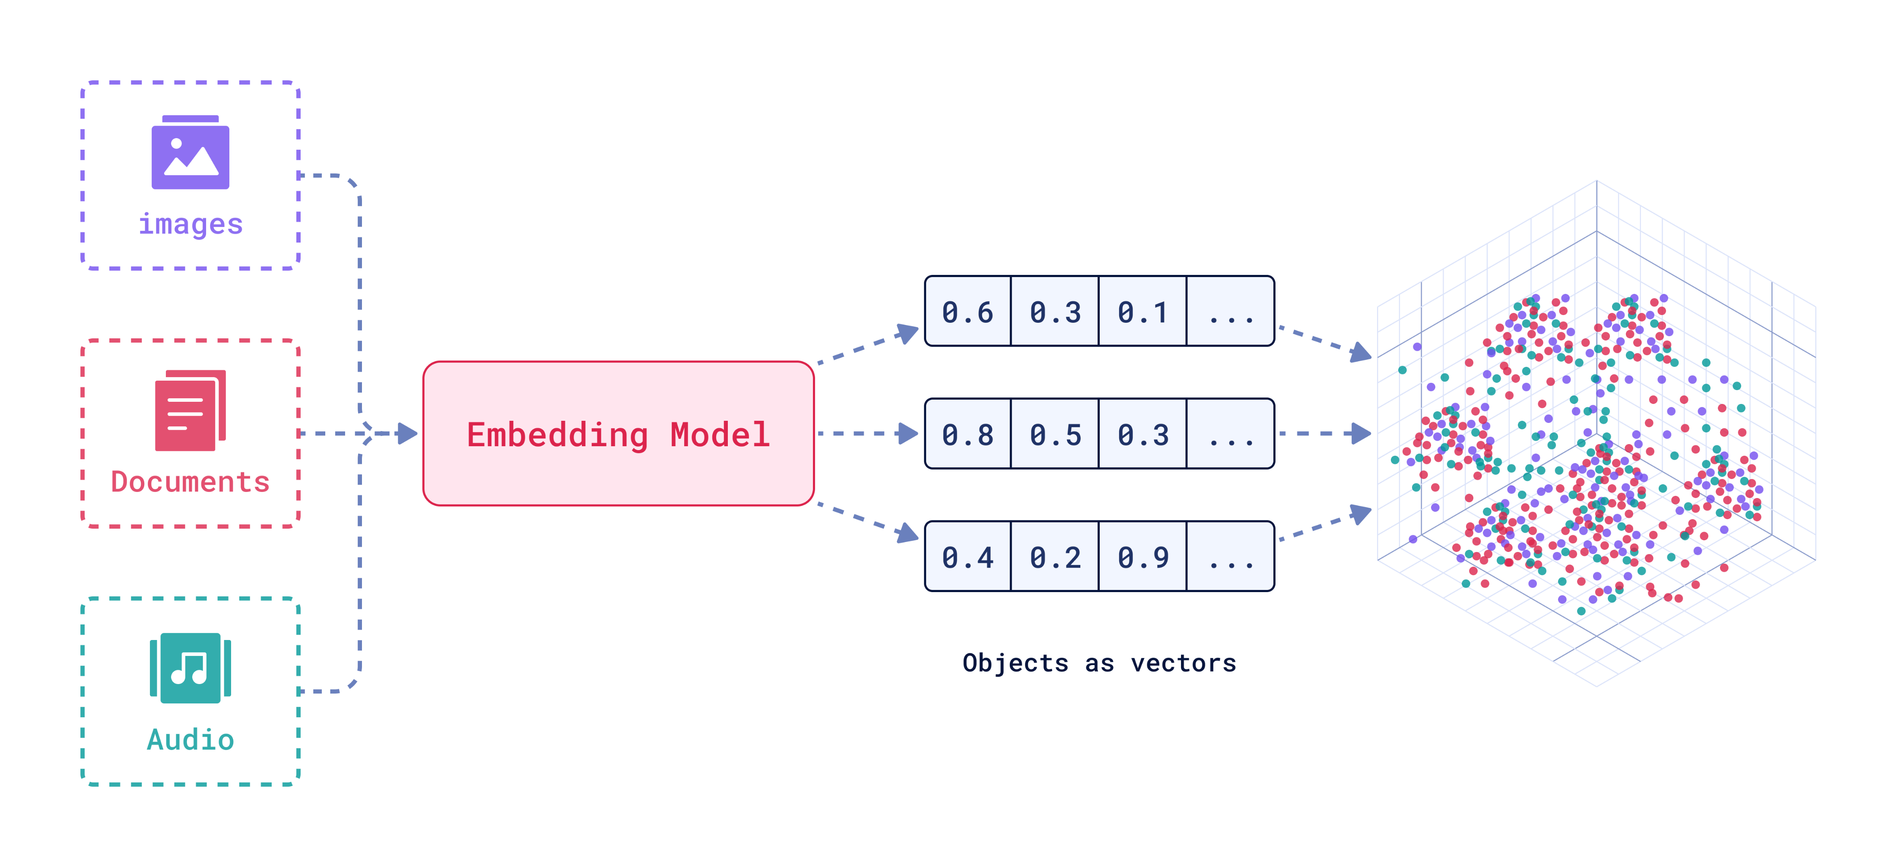
Unstructured data
“Latent space”
Encoder

Slide 40
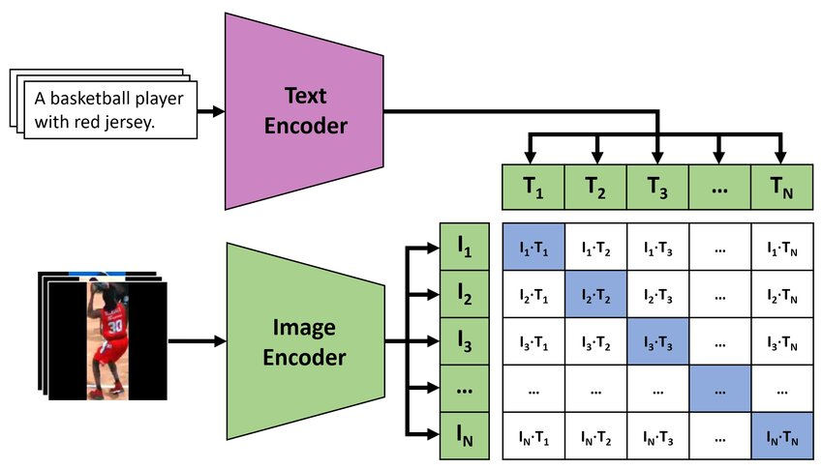
Learn embeddings for images and text that have:
High cosine similarity for matching pairs.
Low cosine similarity for non-matching pairs.

Slide 41
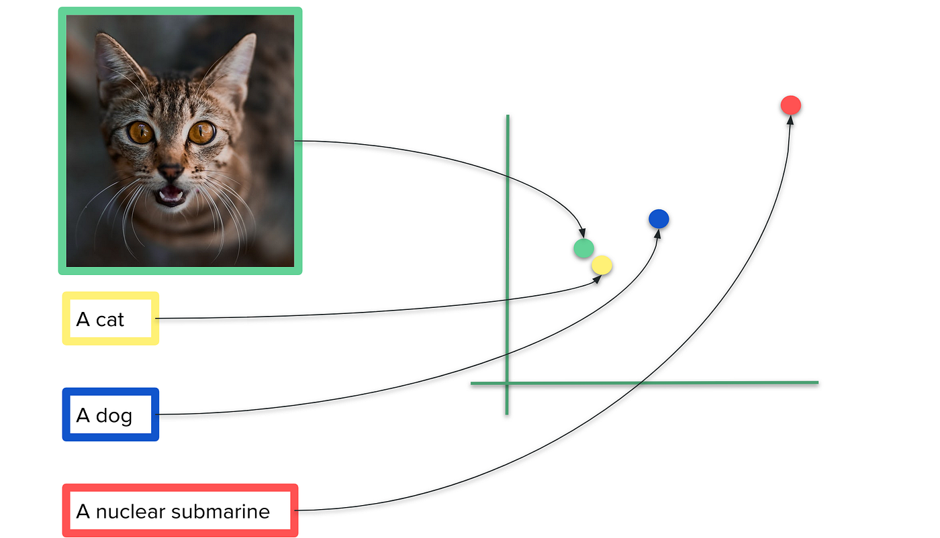
Embeddings
X1
X2
Questions?

Slide 42
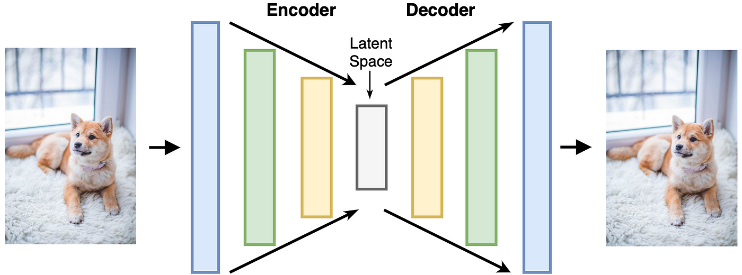
We discussed transforming unstructured data into latent space (embeddings).

Slide 43
We discussed transforming unstructured data into latent space (embeddings).
We could also learn how to go from latent
space back to the transformed data.

Slide 44
Image
Embedding
Image
Encoder
Image
Decoder
Text
Embedding
“A sleek black cat with velvety fur and piercing yellow-green eyes stares intently, exuding an air of mystery and quiet confidence. Its dark, elegant coat contrasts sharply with its vivid gaze, creating a captivating and powerful presence.”
Text
Encoder
High Cosine
Similarity

Slide 45
Image
Embedding
Image
Encoder
Image
Decoder
Text
Embedding
“A sleek black cat with velvety fur and piercing yellow-green eyes stares intently, exuding an air of mystery and quiet confidence. Its dark, elegant coat contrasts sharply with its vivid gaze, creating a captivating and powerful presence.”
Text
Encoder
Similar values!

Slide 46

Image
Embedding
Image
Encoder
Text
Embedding
“A sleek black cat with velvety fur and piercing yellow-green eyes stares intently, exuding an air of mystery and quiet confidence. Its dark, elegant coat contrasts sharply with its vivid gaze, creating a captivating and powerful presence.”
Text
Encoder
Image
Decoder

Slide 47
Image
Embedding
“A sleek black cat with velvety fur and bright, luminous green eyes gazes intently, exuding a sense of calm and quiet confidence. Its elegant posture and soft, shadowy coat create a serene yet powerful presence, while its vivid eyes draw attention with an almost mystical glow.”
Image
Encoder
Text
Decoder
Text
Embedding
“A sleek black cat with velvety fur and piercing yellow-green eyes stares intently, exuding an air of mystery and quiet confidence. Its dark, elegant coat contrasts sharply with its vivid gaze, creating a captivating and powerful presence.”
Text
Encoder

Slide 48
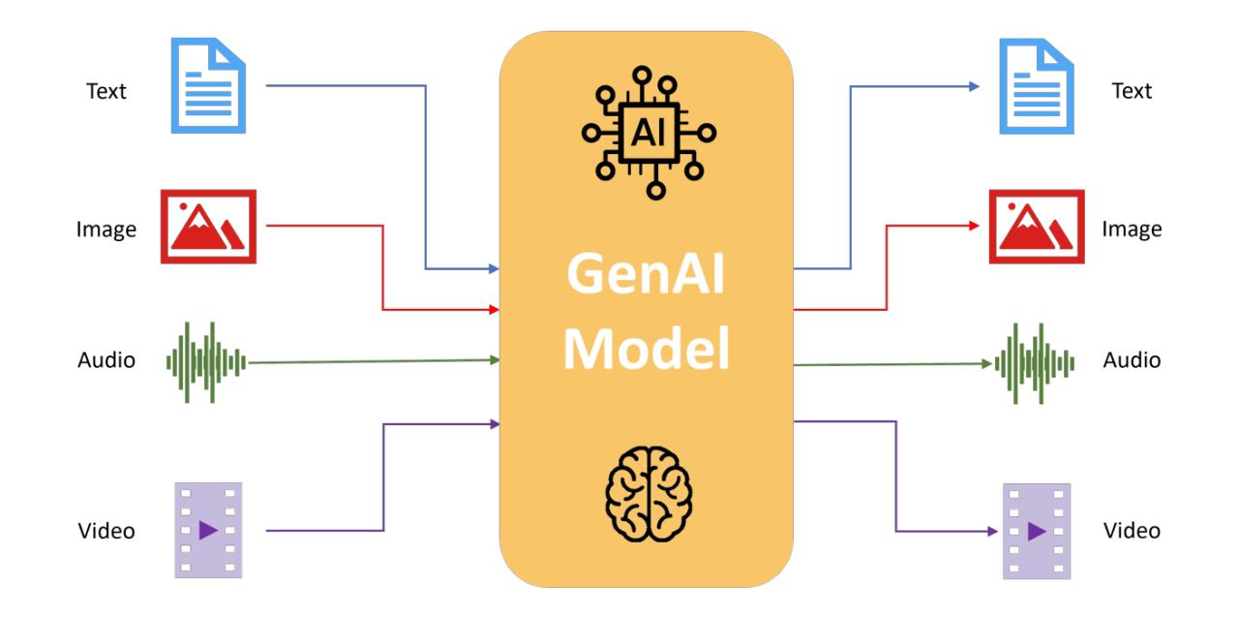
Questions?
Today’s focus.

Slide 49
Is ChatGPT a Large Language Model (LLM)?
It is actually not!

Slide 50
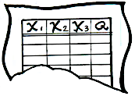





Framework #3: AI in Use vs. Machine Learning
Let’s use our framework to understand ChatGPT.
Machine Learning:
X₁
X₂
X₃
Q
8
T
Red
Yes
12
F
Blue
No
6
T
Blue
Yes
Red
No
Labeled Data
Machine Learning Algorithm
Learned Model
AI in Use (Inference):
X₁
X₂
X₃
Q
Red
?
Action
7
T
Data Instance
Predicted Quantity
Model
Decision Logic

Slide 51

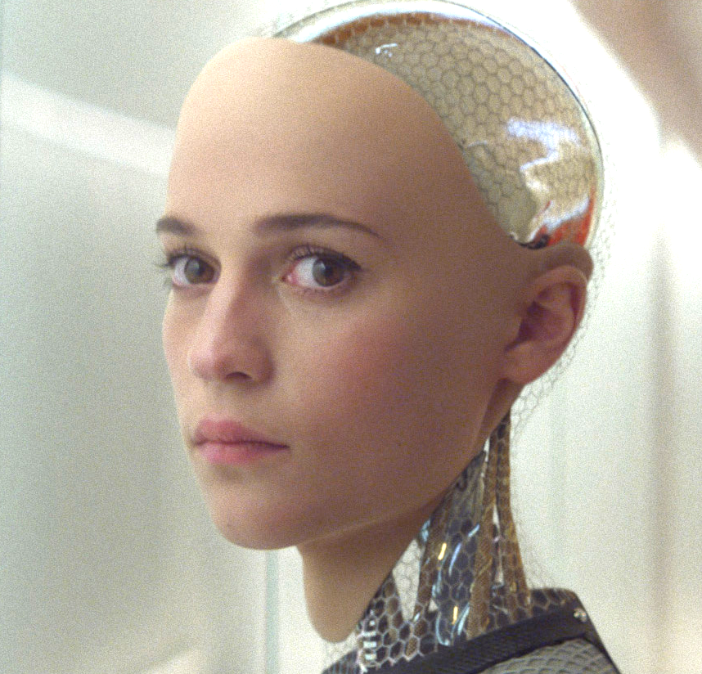
Action
Data Instance
Example: give retention offer (or not)
Example: a customer

Slide 52

Action
Data Instance
A text response.
Text prompt.

Slide 53

The large language model (LLM), such as GPT 3
Action
Predicted Quantity
Data Instance
Decision Logic
Model

Slide 54
GPT stands for:
Generative Pre-trained Transformer

Slide 55
GPT stands for:
Generative Pre-trained Transformer
Let’s discuss what each of these words mean.

Slide 56
What’s the instance?
Large Language Model

Slide 57
What do we want to predict?
A sequence of text:
“The quick brown”
Large Language Model

Slide 58
A sequence of text:
“The quick brown”
The next word:
“fox”
Large Language Model
What are the features?
Generative Pre-trained Transformer

Slide 59
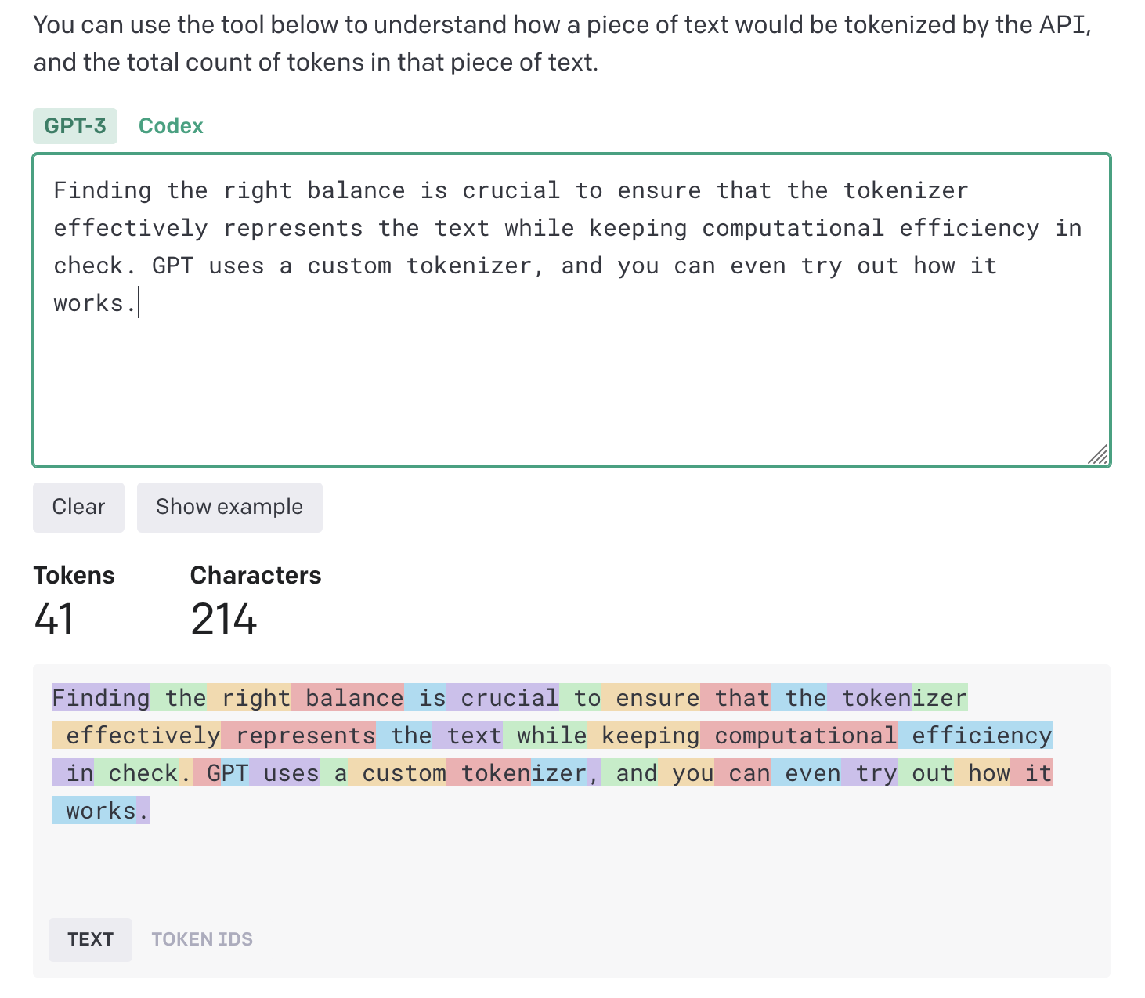

Slide 60
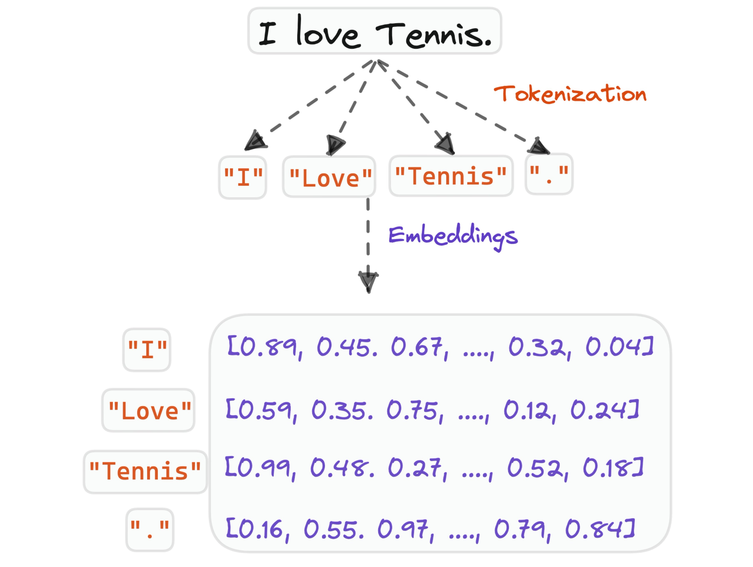

Slide 61
TK | … | T4 | T3 | T2 | T1
Empty | … | Empty | “The” | “quick” | “brown”
The next token:
“fox”
Large Language Model
What is the model’s prediction?

Slide 62
Token | Prob.
“fox” | 70%
“dog” | 10%
“jumps” | 3%
…
“rainbow” | 0.00001%
TK | … | T4 | T3 | T2 | T1
Empty | … | Empty | “The” | “quick” | “brown”
Large Language Model
One probability for each possible token.

Slide 63
And we use some decision logic to pick a token.
Token | Prob.
“fox” | 70%
“dog” | 10%
“jumps” | 3%
…
“rainbow” | 0.00001%
TK | … | T4 | T3 | T2 | T1
Empty | … | Empty | “The” | “quick” | “brown”
Large Language Model
One probability for each possible token.

Slide 64
What do you think happens next?
Token | Prob.
“fox” | 70%
“dog” | 10%
“jumps” | 3%
…
TK | … | T3 | T2 | T1
… | … | “The” | “quick” | “brown”
Next token:
“fox”
Data Instance
Large Language Model
Predicted Quantity
Decision Logic

Slide 65
Token | Prob.
“fox” | 70%
“dog” | 10%
“jumps” | 3%
…
TK | … | T3 | T2 | T1
… | … | “The” | “quick” | “brown”
Next token:
“fox”
Data Instance 1
Large Language Model
Decision Logic
Token | Prob.
“jumps” | 77%
…
Next token:
“jumps”
TK | … | T4 | T3 | T2 | T1
… | … | “The” | “quick” | “brown” | “fox”
Data Instance 2

Slide 66
Questions?
Token | Prob.
“fox” | 70%
“dog” | 10%
“jumps” | 3%
…
TK | … | T3 | T2 | T1
… | … | “The” | “quick” | “brown”
Next token:
“fox”
Data Instance 1
Large Language Model
Decision Logic
Token | Prob.
“jumps” | 77%
…
Next token:
“jumps”
TK | … | T4 | T3 | T2 | T1
… | … | “The” | “quick” | “brown” | “fox”
Data Instance 2
TK | … | T5 | T4 | T3 | T2 | T1
… | … | “The” | “quick” | “brown” | “fox” | “jumps”
Token | Prob.
“over” | 82%
…
Next token:
“over”
Data Instance 3
And this continues until we get the End-Of-Transmission token.

Slide 67
Let’s talk more about the implantation details.
What’s inside this thing?
Large Language Model

Slide 68
Representation $+$ Evaluation $+$ Optimization
Generative Pre-trained Transformer

Slide 69
Representation $+$ Evaluation $+$ Optimization
There are many “architectures” for neural networks, each designed for purpose-specific applications.
Image taken from:
https://www.asimovinstitute.org/neural-network-zoo/

Slide 70
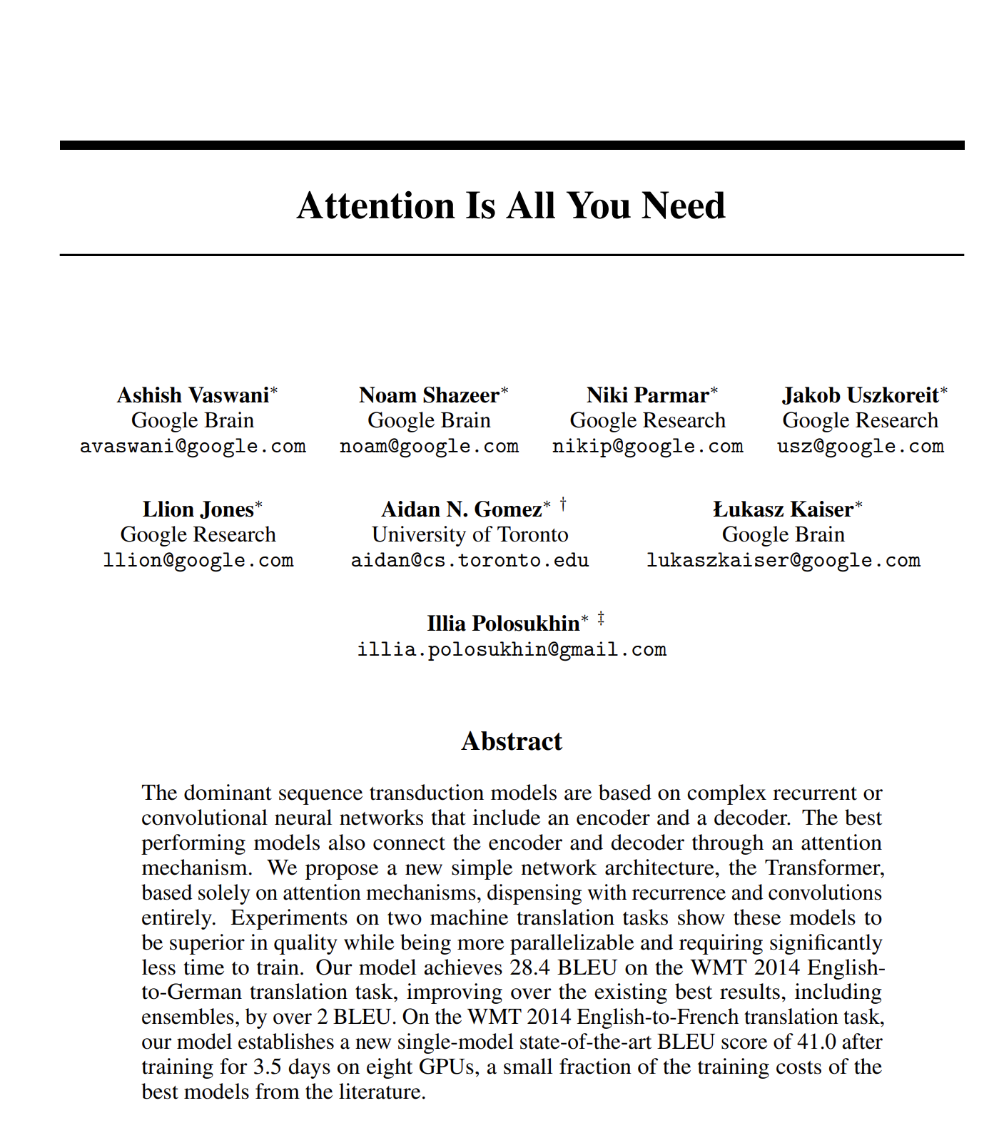
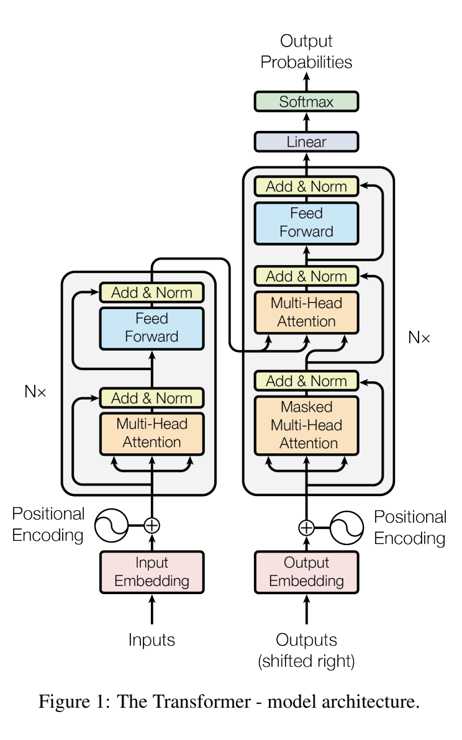
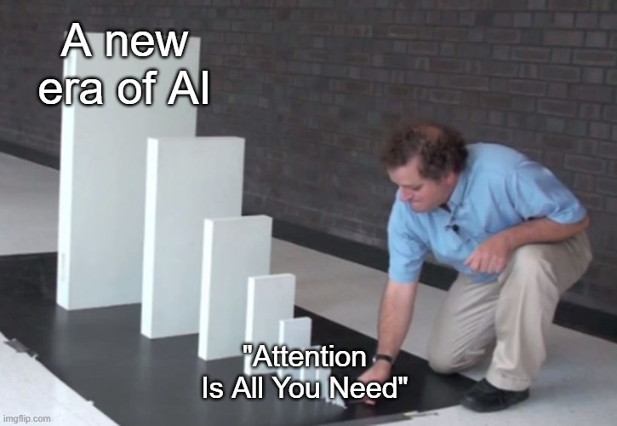
Published in NeurIPS conference in 2017.

Slide 71


Slide 72


Slide 73
Original Transformer
Architecture

Slide 74
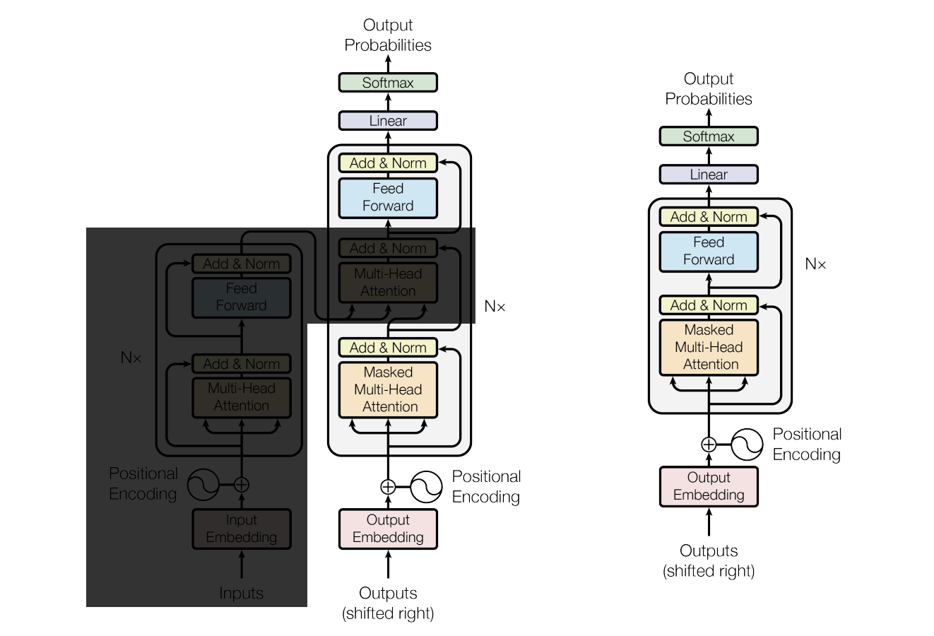
GPT Architecture

Slide 75
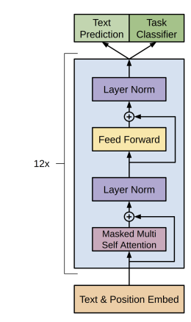
Official diagram of GPT
GPT Architecture

Slide 76
Token | Prob.
“over” | 82%
“the” | 15%
…
TK | … | T3 | T2 | T1
… | … | “brown” | “fox” | “jumps”
Next token:
“over”
Text input
Large Language Model
Predicted Quantity
Decision Logic

Slide 77
TK | … | T3 | T2 | T1
… | … | “fox” | “jumps” | “over”
Next token:
“over”
Text input
Large Language Model

Slide 78
Token | Prob.
“the” | 85%
“there” | 8%
…
TK | … | T3 | T2 | T1
… | … | “fox” | “jumps” | “over”
Next token:
“the”
Text input
Large Language Model
Predicted Quantity
Decision Logic

Slide 79
And this continues until we get the End-Of-Transmission token.
TK | … | T3 | T2 | T1
… | … | “jumps” | “over” | “the”
Next token:
“the”
Text input
Large Language Model

Slide 80
GPT Architecture
It is straightforward to build a GPT model…
~100 lines of code would do it.
But training it is another story!

Slide 81
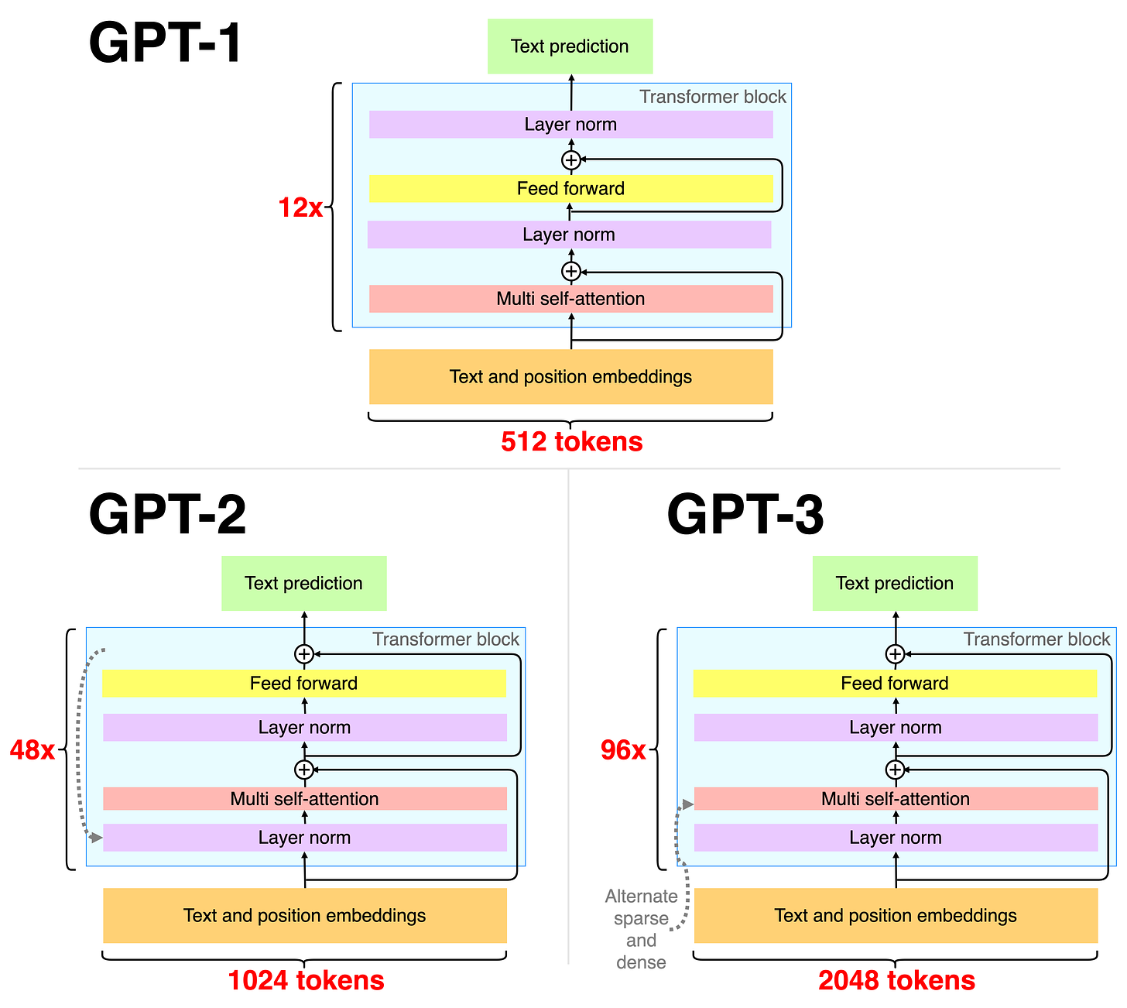
GPT-1, GPT-2, and GPT-3 are very similar.
They differ mostly on:
Number of transformer blocks.
Number of incoming tokens.
The data used and its size.
Questions?

Slide 82
Framework #3: AI in Use vs. Machine Learning
We just discussed this.
Machine Learning:
X₁
X₂
X₃
Q
8
T
Red
Yes
12
F
Blue
No
6
T
Blue
Yes
Red
No
Labeled Data
Machine Learning Algorithm
Learned Model
AI in Use (Inference):
X₁
X₂
X₃
Q
Red
?
Action
7
T
Data Instance
Predicted Quantity
Model
Decision Logic

Slide 83
Framework #3: AI in Use vs. Machine Learning
Let’s discuss this now.
Machine Learning:
X₁
X₂
X₃
Q
8
T
Red
Yes
12
F
Blue
No
6
T
Blue
Yes
Red
No
Labeled Data
Machine Learning Algorithm
Learned Model
AI in Use (Inference):
X₁
X₂
X₃
Q
Red
?
Action
7
T
Data Instance
Predicted Quantity
Model
Decision Logic

Slide 84
Generative Pre-trained Transformer

Slide 85
What sort of data do you think they used to train the models?
Pre-trained on a lot of text data from the Internet.
Then fine-tuned for chatting.

Slide 86
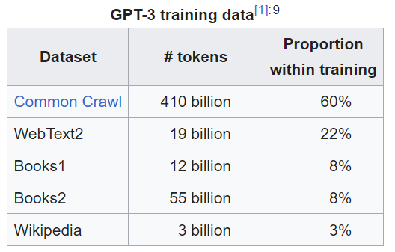
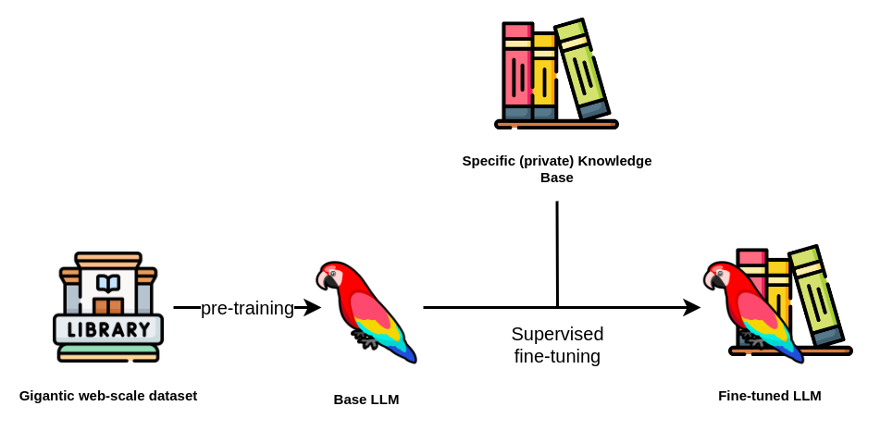
Fine Tuning, Part 1 (curated data)
For example, data from chats or Q&A websites
Questions?
GPT 3
LLM used by ChatGPT
Notes:
Common Crawl: Open source, web crawlers that archives a wide range of publicly accessible web pages. The focus is on breadth and coverage of the internet without particular content filtering.
WebText2 includes content from web pages linked on Reddit, specifically focusing on those with high engagement, such as upvotes. This approach helps filter for quality and relevance, ensuring diverse and informative text.

Slide 87
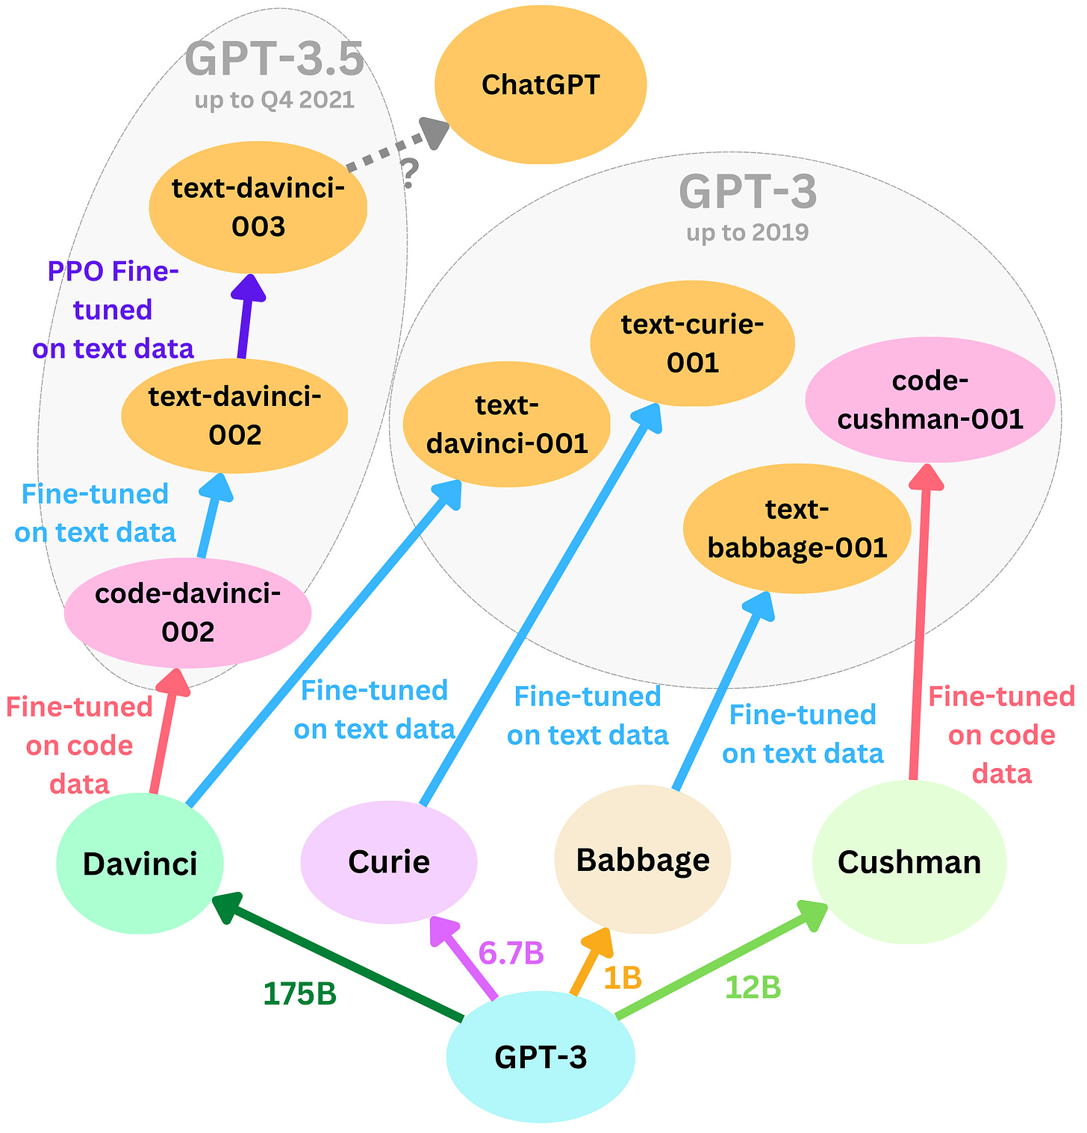
GPT-3 represents a family of models.
The models differ on:
# of parameters
Data used
Training strategy

Slide 88
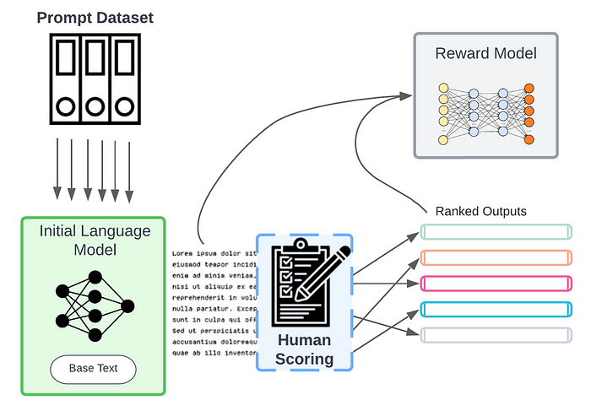
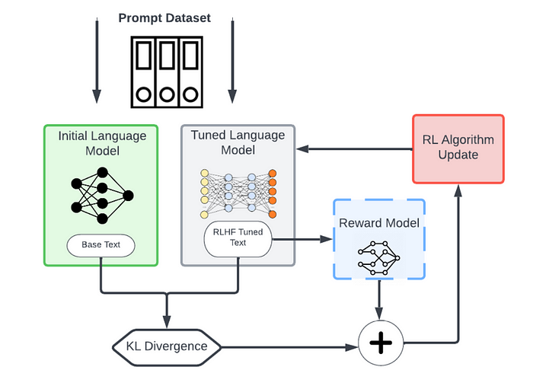
Fine Tuning, Part 2 (human feedback)
Questions?
1
2

Slide 89
Brief interlude on other generative AI. (only if enough time available)

Slide 91
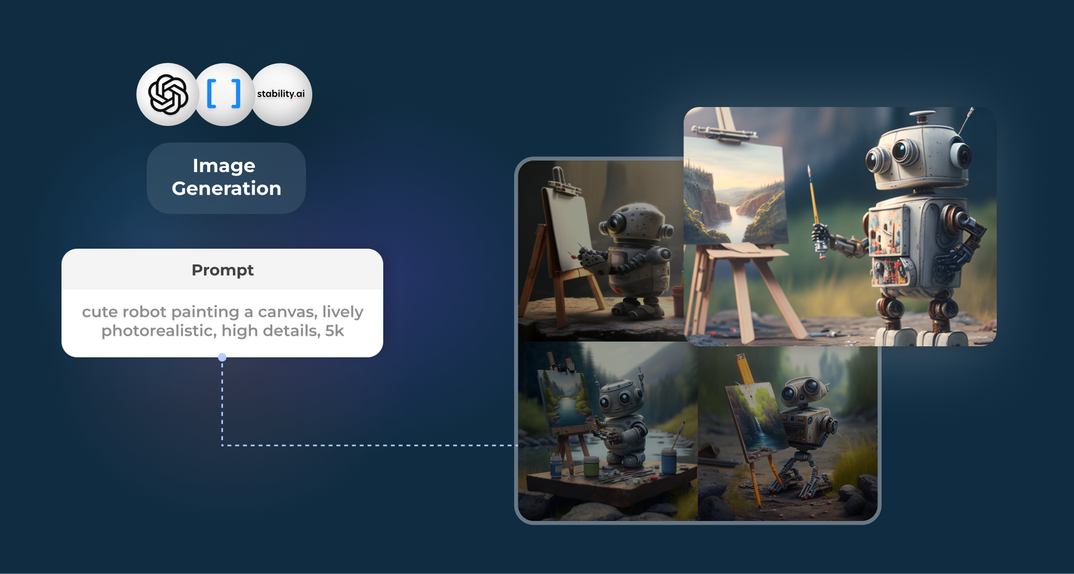
What training data did they use?

Slide 92
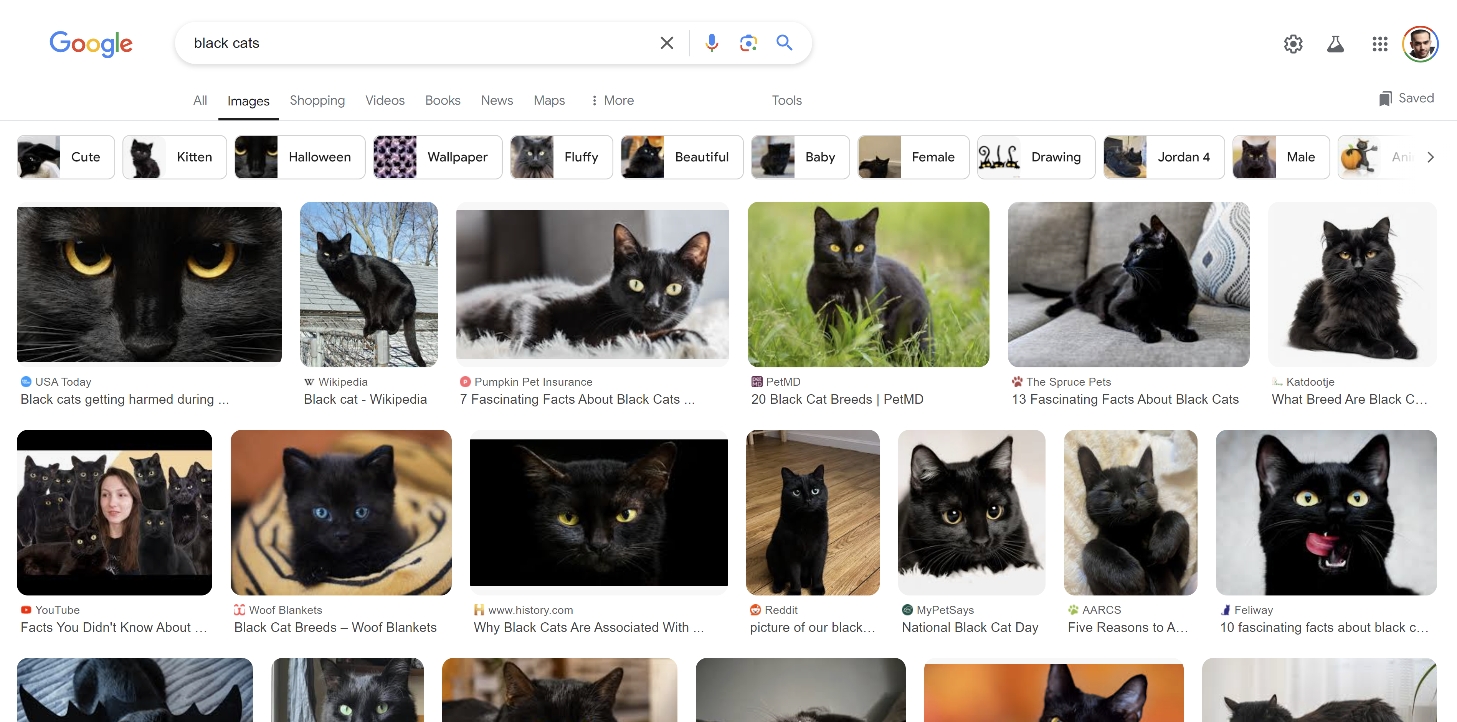

Slide 93
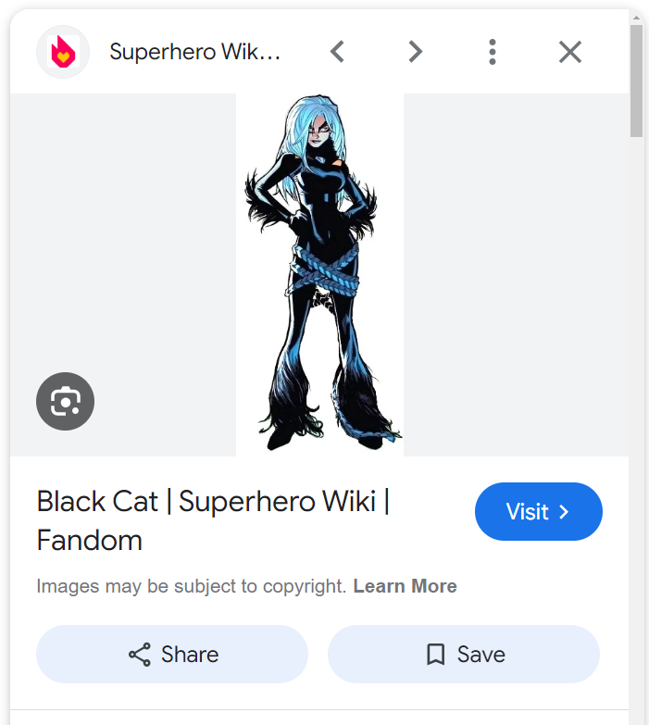
Challenge:
The captions may not always be helpful.

Slide 94
Image
Embedding
Image
Encoder
Text
Embedding
“A sleek black cat with velvety fur and piercing yellow-green eyes stares intently, exuding an air of mystery and quiet confidence. Its dark, elegant coat contrasts sharply with its vivid gaze, creating a captivating and powerful presence.”
Text
Encoder
High Cosine
Similarity

Slide 95
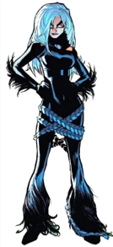
GPT 3
Image
Embedding
Image
Encoder
Text
Decoder
“A confident figure dressed in a sleek black bodysuit with blue accents and white hair, featuring feathered details and wrapped in intricate blue ropes, exuding mystery and strength.”
OLD CAPTION:
Black Cat |Superhero Wiki | Fandom

Slide 96
Image
Embedding
Image
Encoder
Text
Decoder
“A confident figure dressed in a sleek black bodysuit with blue accents and white hair, featuring feathered details and wrapped in intricate blue ropes, exuding mystery and strength.”
NEW CAPTION:
“A confident figure dressed in a sleek black bodysuit with blue accents and white hair, featuring feathered details and wrapped in intricate blue ropes, exuding mystery and strength.”
OLD CAPTION:
Black Cat |Superhero Wiki | Fandom

Slide 97
Image
Embedding
Image
Encoder
Image
Decoder
Text
Embedding
NEW CAPTION:
“A confident figure dressed in a sleek black bodysuit with blue accents and white hair, featuring feathered details and wrapped in intricate blue ropes, exuding mystery and strength.”
Text
Encoder
High Cosine
Similarity

Slide 98

Image
Embedding
Image
Encoder
Text
Embedding
NEW CAPTION:
“A confident figure dressed in a sleek black bodysuit with blue accents and white hair, featuring feathered details and wrapped in intricate blue ropes, exuding mystery and strength.”
Text
Encoder
Image
Decoder

Slide 99
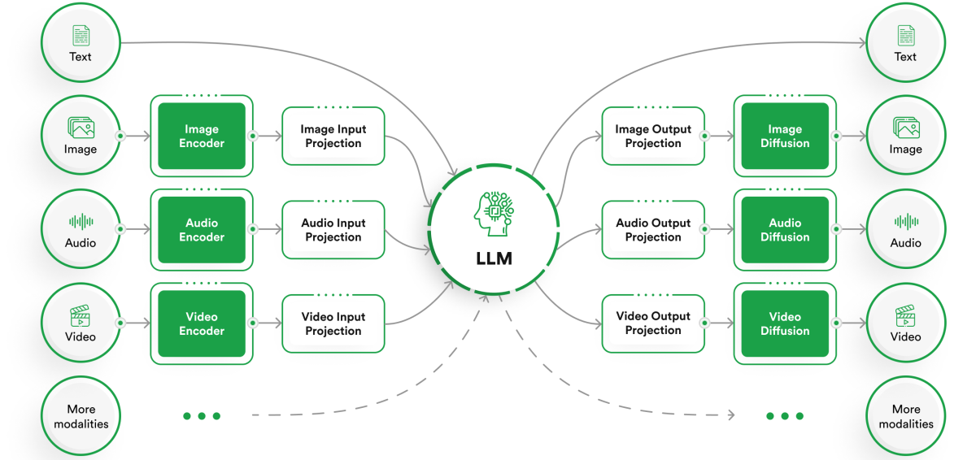

Slide 100
Back to ChatGPT.

Slide 101
Recall that:
Large Language Model
AI System
Let’s talk about this now.

Slide 102
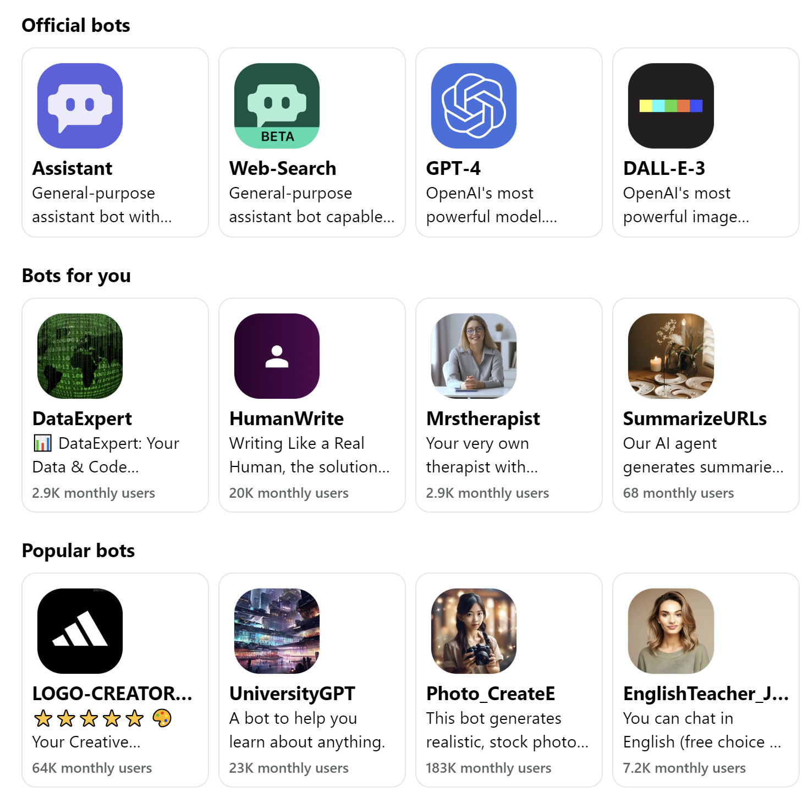

Slide 103
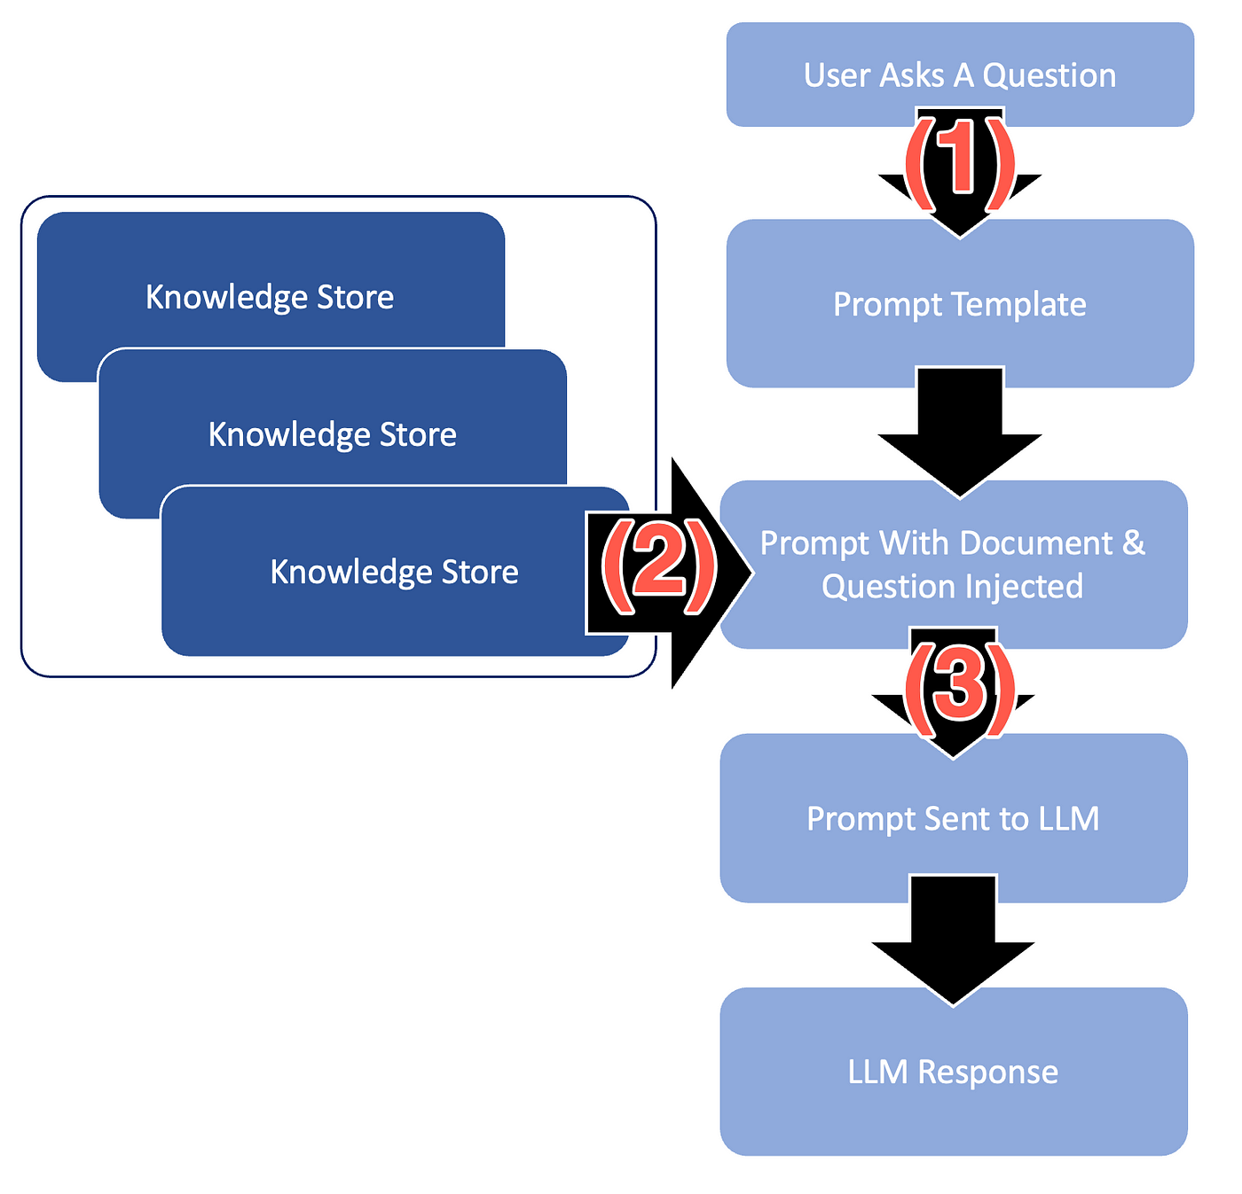
Prompt design
Let’s do an example
with a virtual doctor.

Slide 104
User asks a question:
What should I do about my frequent headaches?
Prompt template:
User asked: "[USER_QUESTION]"
Patient's Health History:
- Age: [AGE]
- Existing Conditions: [CONDITIONS]
- Medications: [MEDICATIONS]
- Lifestyle Factors: [LIFESTYLE]
Relevant Medical Information:
- Common Causes: [CAUSES]
- Treatment Options: [TREATMENTS]
- When to Seek Help: [SEEK_HELP]
Provide a detailed response to the user incorporating this information.

Slide 105
User asks a question:
What should I do about my frequent headaches?
Prompt template:
User asked: What should I do about my frequent headaches?
Patient's Health History:
- Age: [AGE]
- Existing Conditions: [CONDITIONS]
- Medications: [MEDICATIONS]
- Lifestyle Factors: [LIFESTYLE]
Relevant Medical Information:
- Common Causes: [CAUSES]
- Treatment Options: [TREATMENTS]
- When to Seek Help: [SEEK_HELP]
Provide a detailed response to the user incorporating this information.

Slide 106
User asks a question:
What should I do about my frequent headaches?
Prompt template:
User asked: What should I do about my frequent headaches?
Patient's Health History:
- Age: 35
- Existing Conditions: Hypertension
- Medications: Lisinopril
- Lifestyle Factors: Sedentary, high-stress job
Relevant Medical Information:
- Common Causes: [CAUSES]
- Treatment Options: [TREATMENTS]
- When to Seek Help: [SEEK_HELP]
Provide a detailed response to the user incorporating this information.
Patient data
from medical records

Slide 107
User asks a question:
What should I do about my frequent headaches?
Prompt template:
User asked: What should I do about my frequent headaches?
Patient's Health History:
- Age: 35
- Existing Conditions: Hypertension
- Medications: Lisinopril
- Lifestyle Factors: Sedentary, high-stress job
Relevant Medical Information:
- Common Causes: Stress, poor posture, dehydration
- Treatment Options: Drink more water, take more breaks, relaxation techniques
- When to Seek Help: If headaches persist or worsen, consult a healthcare provider
Provide a detailed response to the user incorporating this information.
How can we fill this?

Slide 108
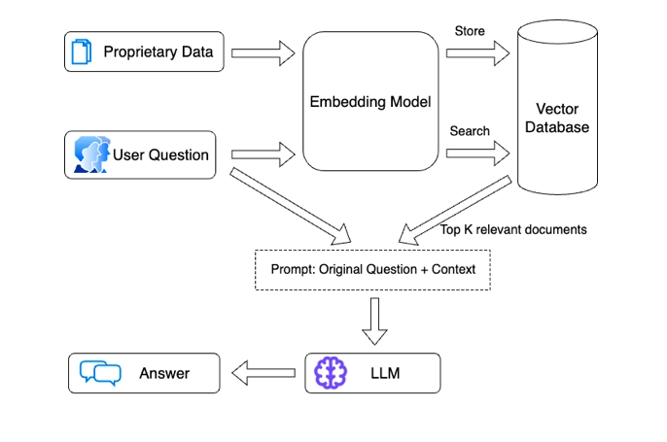
Retrieval Augmented Generation (RAG)

Slide 109
Prompt Chaining
User question
Prompt for
common causes
Patient data

Slide 110
Prompt Chaining
User question
Prompt for
common causes
Prompt for
treatment options
Patient data

Slide 111
Prompt Chaining
User question
Prompt for
common causes
Prompt for
treatment options
Prompt for
when to seek help
Patient data

Slide 112
Prompt Chaining
User question
Prompt for
common causes
Prompt for
treatment options
Prompt for
when to seek help
Prompt for
Final response
Patient data

Slide 113
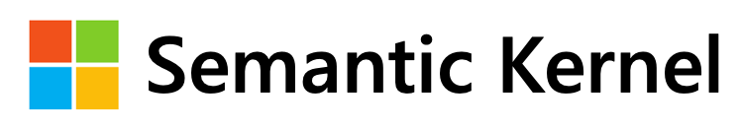


Slide 114
Prompt design
Questions?

Slide 115

Microsoft Build 2023: AI Redefines Software Development and Future of Work.

Slide 116

User asks a question:
What should I do about my frequent headaches?
“Frequent headaches require attention to lifestyle and medical factors. At age 35, and with a condition like hypertension, you should…”

Slide 117
How do we evaluate LLM-based systems?

Slide 118



Champion Challenger Approach
Questions?

Slide 119

Be careful who you trust.

